Slide 1
Problem Statement :- Metadata-driven data ingestion process
Architect :- Mataprasad Agrawal
Mentor :- Swapnil Bambal, Ankush Sarna

Slide 2
Problem Statement
A metadata-driven data ingestion process to source data from a system and load into a target system.
What is MetaData?
Metadata summarizes basic information about data, which can make it easier to find, use and reuse particular instances of data.

Slide 3
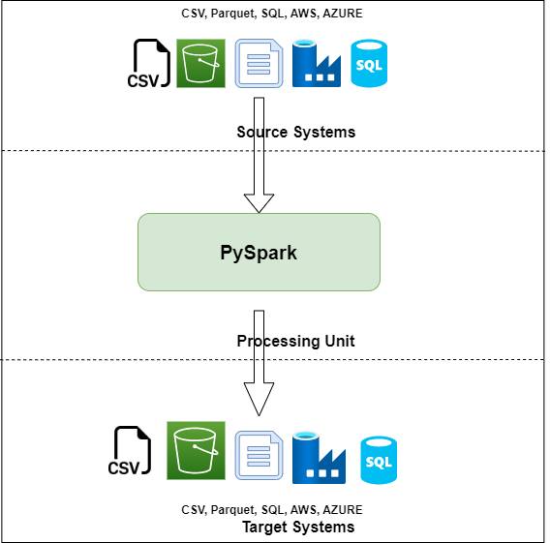
System Workflow

Slide 4
Worked on
Tech Stack
Python
PySpark
MySQL
Hadoop
PostgreSQL
IDE Used
Visual Studio Code
Jupyter Notebook

Slide 5
Test Cases
Able to define metadata in the config/YAML/JSON file (before run)
Able to change(update/delete) metadata in the config file (subsequent runs should pull new config change)
Able to run the data transfer process with no data loss or inflation, re-runs should not cause data corruption
Able to source data from file format and write to another file format (csv-to-csv, csv-to-parquet, parquet-to-csv etc.)
Able to source data from file format and write to NoSQL (csv-to-Couchbase, ... etc.)
Able to source data from RDBMS and write to file formats (pgSQL-to-csv, pgSQL-to-parquet etc.)

Slide 6
Future Scope
Currently we have worked on CLI, we can add GUI to ingestion System
We can optimize our system for Big data.

Slide 7
Team:
Shubham Chaudhari
Sai Attunuru
Supriya Mangnale
Shivani Dwarke
Priyanka Nigam
Mansi Sankaye

Slide 8
Thank You !!

